Slide 2
ATHENA
Student Account Services Orientation

Slide 3
Contact Information
Website: www.bursar.uga.edu
Email Address: stuacct@uga.edu
Location: 424 E. Broad Street, Athens, GA 30602
Office Hours: Monday – Friday 8:00am-5:00pm (Closed from 12:30pm-1:30pm Daily)
bursar.uga.edu

Slide 4
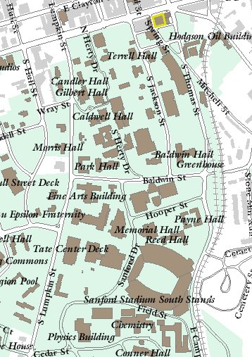
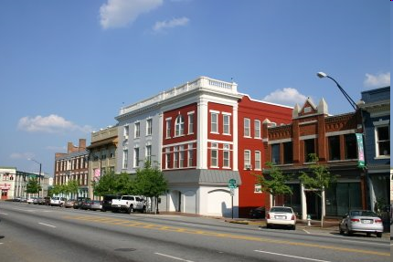
bursar.uga.edu

Slide 5
Payment Deadlines
Fall 2023 dates to remember:
1st Due Date: August 16, 2023
2nd Due Date (Drop/Add Activity): August 23, 2023
Late Fee Assessed: August 28, 2023
Schedule Cancellation: August 31, 2023
bursar.uga.edu

Slide 6
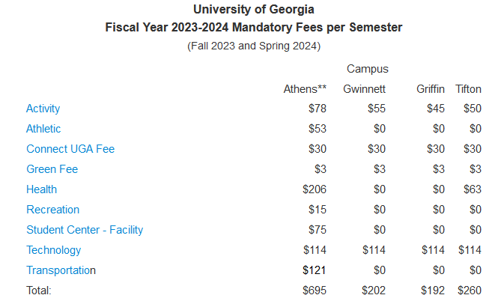
Tuition and Fees per Semester
Flat Tuition Rate
6 or less hrs.
$2,909/$8,555
More than 6 hrs.
$4,895/$14,415
(in state/ out of state)
Note: Total Tuition and Fees for the Semester = Tuition Rate + Student Fees
bursar.uga.edu

Slide 7
ATHENA Student Account
Access at athena.uga.edu
Centralized electronic billing system for University charges
Tuition, Housing, Dining Services, Parking, etc.
Notification Method
Email - CHECK ON A REGULAR BASIS!
bursar.uga.edu

Slide 8
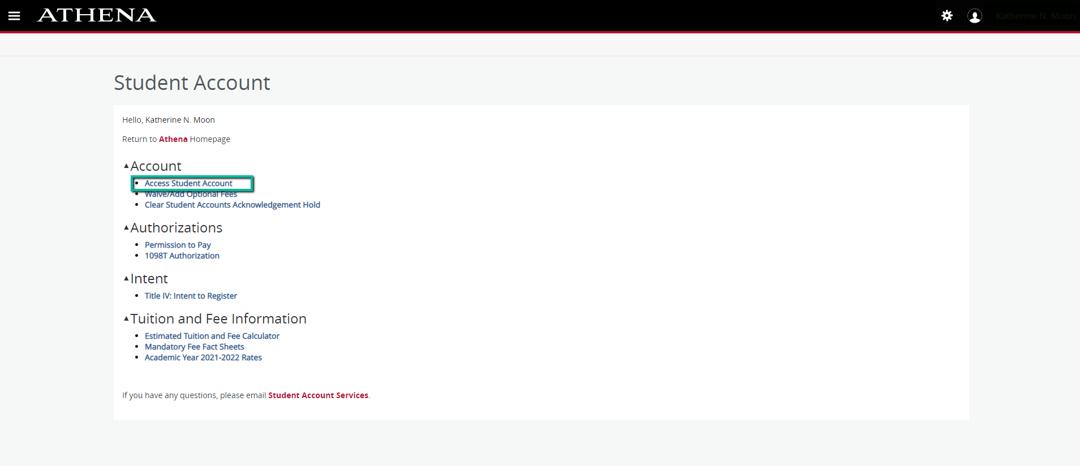
bursar.uga.edu

Slide 9
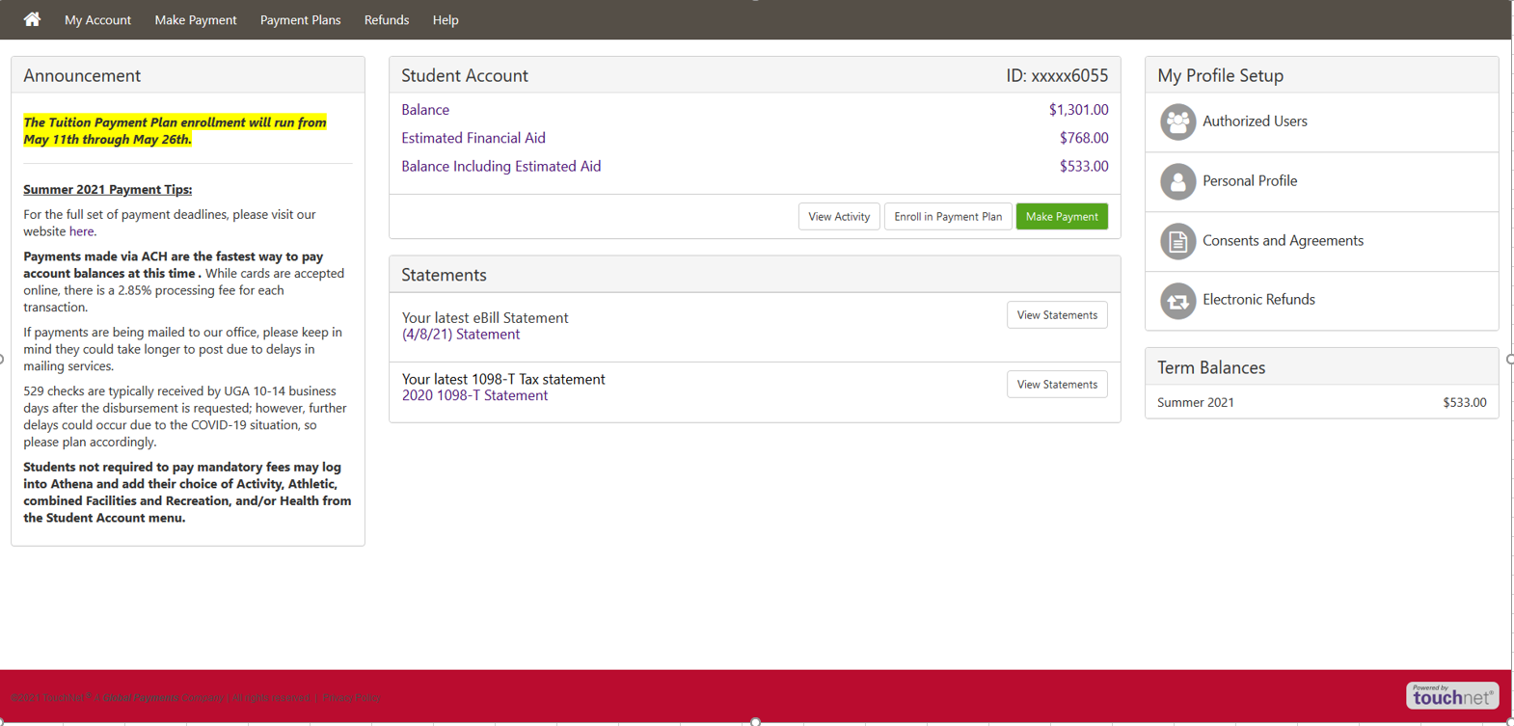
bursar.uga.edu

Slide 10
Understanding Your Account
eStatements
Printable bill
Only as current as date on statement
Recent Account Activity
Any activity after statement date
Balance due
Statement amount + recent account activity
bursar.uga.edu

Slide 11
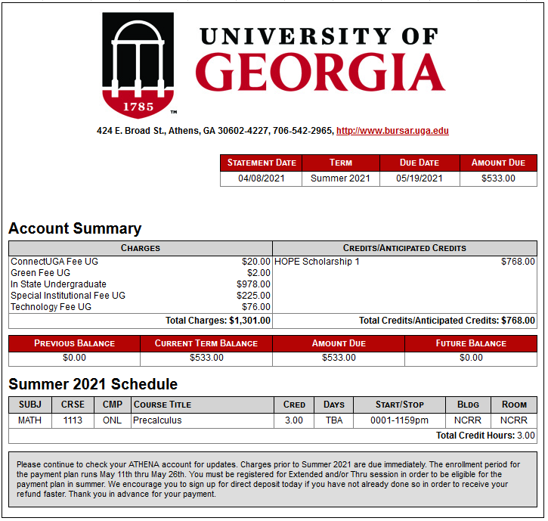
bursar.uga.edu

Slide 12
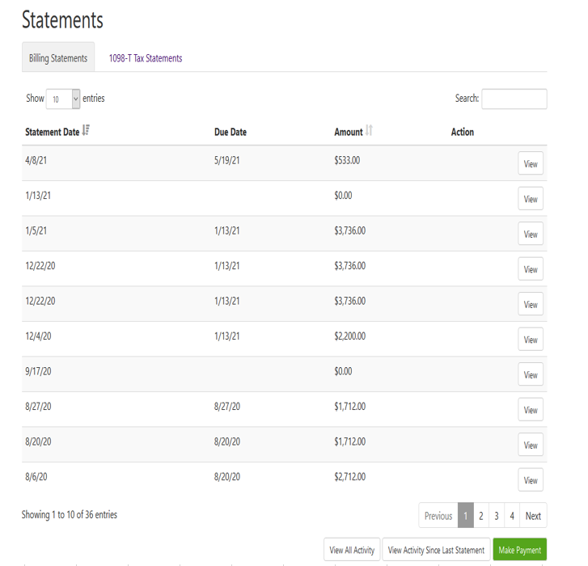
bursar.uga.edu

Slide 13
Payment Options
Online via Student Account
Credit and debit cards
Accept MasterCard, Visa, American Express, and Discover
2.95% convenience fee, minimum of $3.00
Electronic Check
No fee associated
Store multiple bank accounts
Payment Plan
$75.00 non-refundable enrollment fee
Allows payment for up to 50% of the current term’s tuition and mandatory fees, housing, and dining charges or the account balance, whichever is less. The deferred amounts are automatically drafted on predetermined installment dates.
529 Plans
Payment should NOT exceed current amount due for the TERM.
Electronic Payment Option Available directly to UGA for SOME state 529 plans.
Please allow 10-14 days for processing if you are requesting disbursement via check.
For more information, see the Payments section of the Student & Parents area at bursar.uga.edu
bursar.uga.edu

Slide 14
Beginning of Semester Checklist
Grant Authorized User Access
Parents, guardians, employers, etc. with separate access to view/pay bill on student’s behalf
WILL NOT receive student account emails
Set Up Direct Deposit for Refunds
Fastest way to receive financial aid overpayments and account credits
Paper checks mailed otherwise
Permission to Pay
Student Account menu in Athena
Allows the student to authorize their Federal and State Financial Aid to pay for ‘other’ charges such as miscellaneous fees, returned check fees, parking, late fees, health insurance, etc.
bursar.uga.edu

Slide 15
Welcome to UGA!
Student Account representatives are available by phone, email, or in person to assist you with any questions you may have about your account or your billing.

